Slide 1

Analysis of Dynamic Models: Eigenvalue Methods
MTH 564 – Mathematical Modeling

Slide 2

Overview
You cannot get exact solutions for most dynamical models that arise in practice.
In the previous chapter we examined graphical techniques to studying discrete and continuous dynamical system.
We now look at other techniques for analyzing a dynamical system.
Eigenvalues
Phase portraits.
Our goal is to provide important qualitative information when exact analytic solutions are impossible to obtain.

Slide 3
Competitive Species (Again)
Reconsider the tree problem:
In an unmanaged track of forest hardwood and softwood compete for land and water resources. The more desirable hardwood trees grow more slowly but are more durable and produce more valuable timber. Softwood trees compete with hardwoods by growing rapidly and consuming the available water soil nutrients. Hardwoods compete by growing taller than softwoods can and shading new seedlings. Hardwoods are also more resistant to disease. Can these two types of trees coexist on one tract of forest indefinitely, or will one type of tree drive the other to extinction?
We now add the following assumptions:
Hardwoods grow at a rate of 10% per year
Softwoods grow at a rate of 25% per year.
An acre of forest land can support about 10,000 tons of hardwoods or 6,000 tons of softwoods.

Slide 4
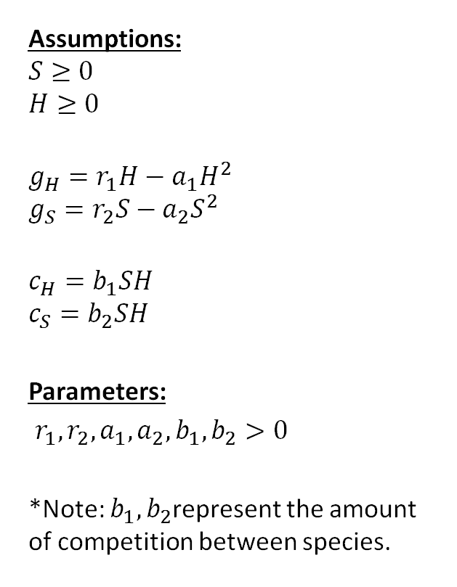
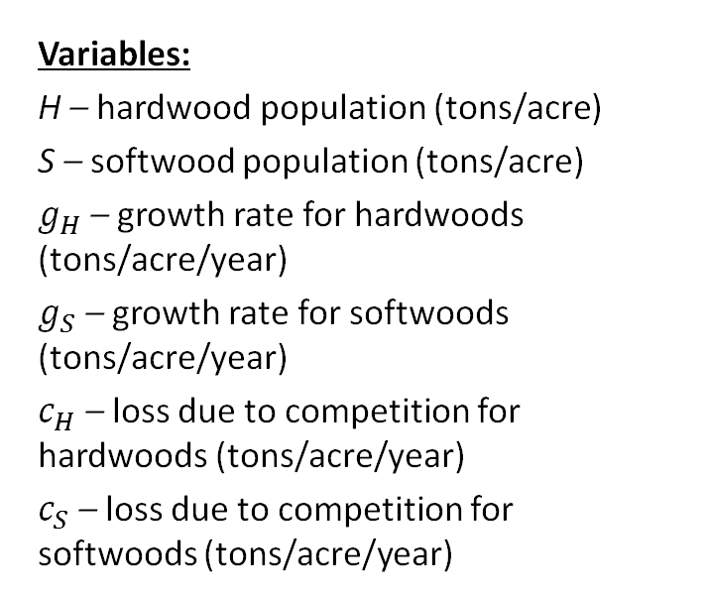
Step 1: Previously
Variables:
H – hardwood population (tons/acre)
S – softwood population (tons/acre)
$g_{H}$ – growth rate for hardwoods (tons/acre/year)
$g_{S}$ – growth rate for softwoods (tons/acre/year)
$c_{H}$ – loss due to competition for hardwoods (tons/acre/year)
$c_{S}$ – loss due to competition for softwoods (tons/acre/year)
Assumptions:
$$S≥0$$
$$H≥0$$
$$g_{H}=r_{1}H−a_{1}H^{2}$$
$$g_{S}=r_{2}S−a_{2}S^{2}$$
$$c_{H}=b_{1}SH$$
$$c_{S}=b_{2}SH$$
Parameters:
$r_{1},r_{2}, a_{1},a_{2},b_{1},b_{2}>0$
*Note: $b_{1},b_{2}$represent the amount of competition between species.
Objective
Determine whether H or S approach 0

Slide 5
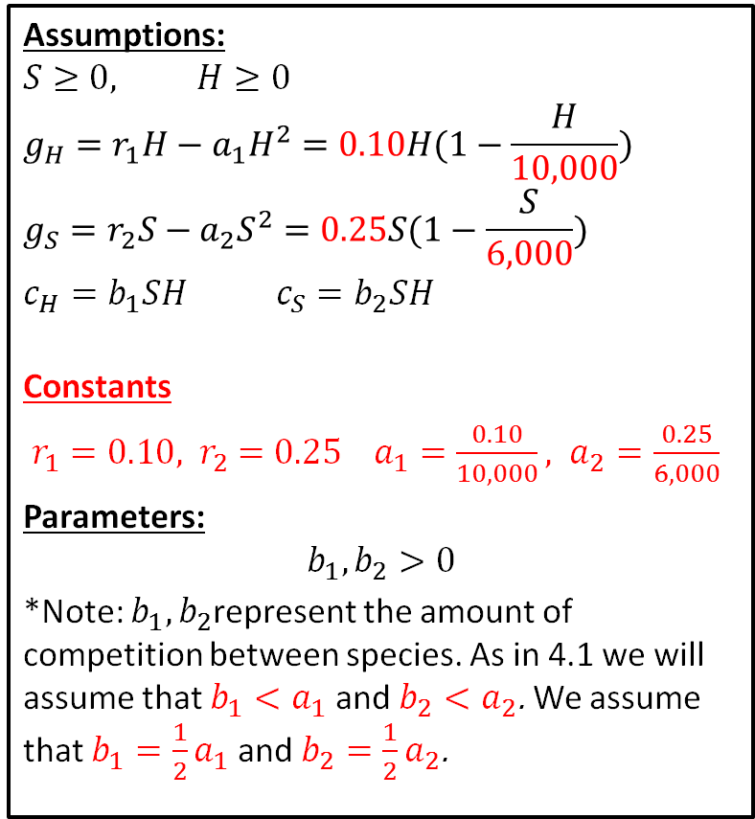
Step 1: Now
Variables:
H – hardwood population (tons/acre)
S – softwood population (tons/acre)
$g_{H}$ – growth rate for hardwoods (tons/acre/year)
$g_{S}$ – growth rate for softwoods (tons/acre/year)
$c_{H}$ – loss due to competition for hardwoods (tons/acre/year)
$c_{S}$ – loss due to competition for softwoods (tons/acre/year)
Assumptions:
$$S≥0, H≥0$$
$$g_{H}=r_{1}H−a_{1}H^{2}=0.10H(1−\frac{H}{10,000})$$
$$g_{S}=r_{2}S−a_{2}S^{2}=0.25S(1−\frac{S}{6,000})$$
$$c_{H}=b_{1}SH{ c}_{S}=b_{2}SH$$
Constants
$r_{1}=0.10, { r}_{2}=0.25 a_{1}=\frac{0.10}{10,000}, a_{2}=\frac{0.25}{6,000}$
Parameters:
$$b_{1},b_{2}>0$$
*Note: $b_{1},b_{2}$represent the amount of competition between species. As in 4.1 we will assume that ${b_{1}<a}_{1}$ and ${b_{2}<a}_{2}$. We assume that ${b_{1}=\frac{1}{2}a}_{1}$ and ${b_{2}=\frac{1}{2}a}_{2}$.
Objective
Determine whether H or S approach 0

Slide 6
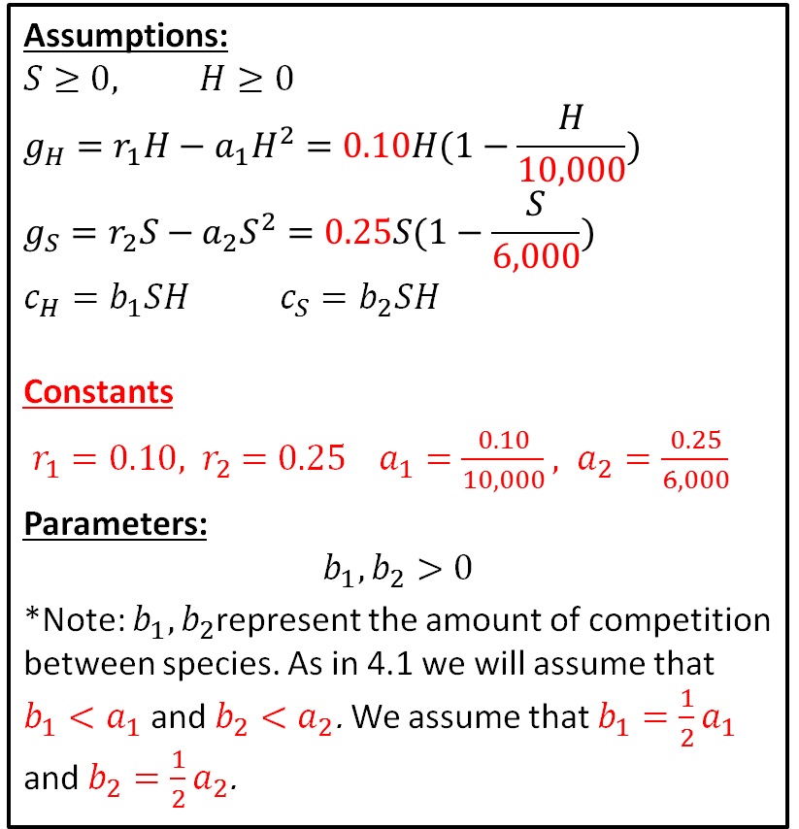
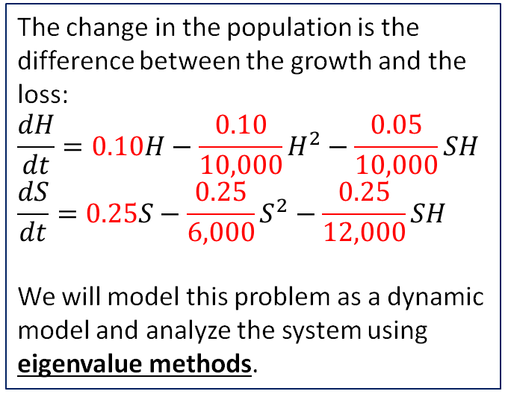
Step 2: Select the modeling approach
Assumptions:
$$S≥0, H≥0$$
$$g_{H}=r_{1}H−a_{1}H^{2}=0.10H(1−\frac{H}{10,000})$$
$$g_{S}=r_{2}S−a_{2}S^{2}=0.25S(1−\frac{S}{6,000})$$
$$c_{H}=b_{1}SH{ c}_{S}=b_{2}SH$$
Constants
$r_{1}=0.10, { r}_{2}=0.25 a_{1}=\frac{0.10}{10,000}, a_{2}=\frac{0.25}{6,000}$
Parameters:
$$b_{1},b_{2}>0$$
*Note: $b_{1},b_{2}$represent the amount of competition between species. As in 4.1 we will assume that ${b_{1}<a}_{1}$ and ${b_{2}<a}_{2}$. We assume that ${b_{1}=\frac{1}{2}a}_{1}$ and ${b_{2}=\frac{1}{2}a}_{2}$.
The change in the population is the difference between the growth and the loss:
$$\frac{dH}{dt}=0.10H−\frac{0.10}{10,000}H^{2}−\frac{0.05}{10,000}SH$$
$$\frac{dS}{dt}=0.25S−\frac{0.25}{6,000}S^{2}−\frac{0.25}{12,000}SH$$
We will model this problem as a dynamic model and analyze the system using eigenvalue methods.
Objective
Determine whether H or S approach 0

Slide 7
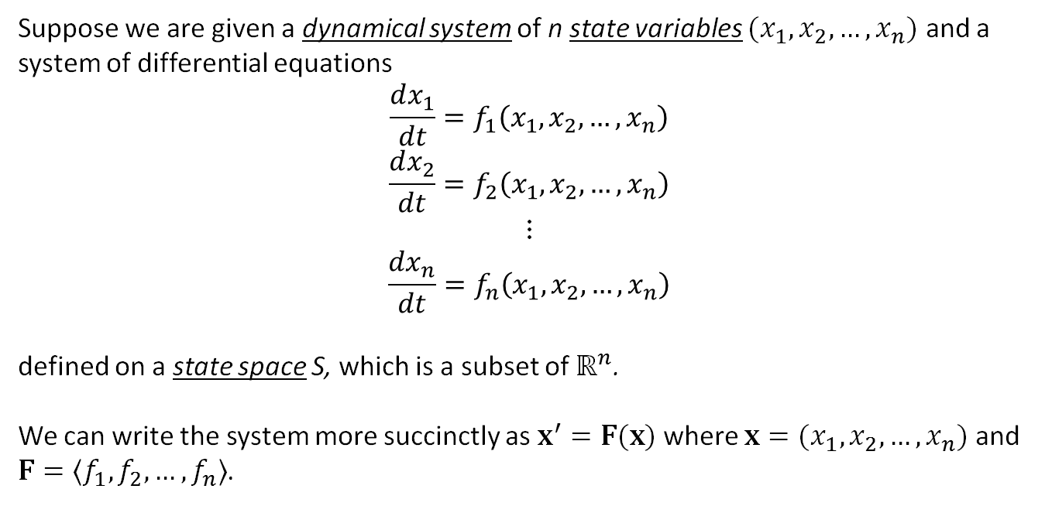
Dynamic Systems: Eigenvalues
Suppose we are given a dynamical system of n state variables $(x_{1},x_{2},…,x_{n})$ and a system of differential equations
$$\frac{dx_{1}}{dt}=f_{1}\left(x_{1},x_{2},…,x_{n}\right)$$
$$\frac{dx_{2}}{dt}=f_{2}\left(x_{1},x_{2},…,x_{n}\right)$$
$$⋮$$
$$\frac{dx_{n}}{dt}=f_{n}\left(x_{1},x_{2},…,x_{n}\right)$$
defined on a state space S, which is a subset of $ℝ^{n}$.
We can write the system more succinctly as $x^{′}=F(x)$ where $x=(x_{1},x_{2},…,x_{n})$ and $F=〈f_{1},f_{2}, …, f_{n}〉$.

Slide 8
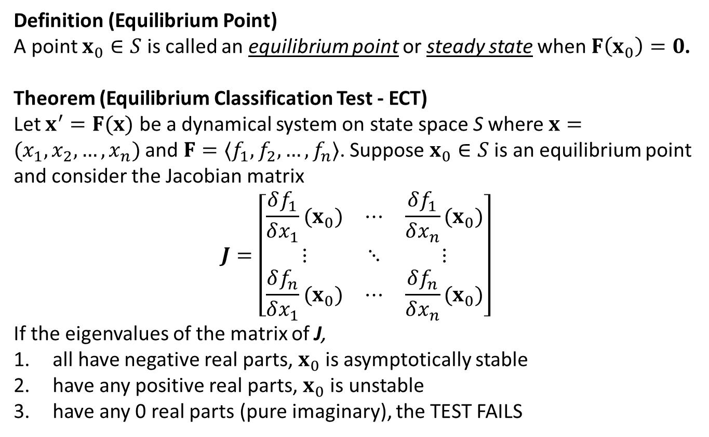
Dynamic Systems: ECT
Definition (Equilibrium Point)
A point $x_{0}∈S$ is called an equilibrium point or steady state when $F\left(x_{0}\right)=0$.
Theorem (Equilibrium Classification Test - ECT)
Let $x^{′}=F(x)$ be a dynamical system on state space S where $x=(x_{1},x_{2},…,x_{n})$ and $F=〈f_{1},f_{2}, …, f_{n}〉$. Suppose $x_{0}∈S$ is an equilibrium point and consider the Jacobian matrix
$$J=\left[\begin{matrix}\frac{δf_{1}}{δx_{1}}(x_{0}) & ⋯ & \frac{δf_{1}}{δx_{n}}(x_{0}) \\ ⋮ & ⋱ & ⋮ \\ \frac{δf_{n}}{δx_{1}}(x_{0}) & ⋯ & \frac{δf_{n}}{δx_{n}}(x_{0})\end{matrix}\right]$$
If the eigenvalues of the matrix of J,
all have negative real parts, $x_{0}$ is asymptotically stable
have any positive real parts, $x_{0}$ is unstable
have any 0 real parts (pure imaginary), the TEST FAILS

Slide 9
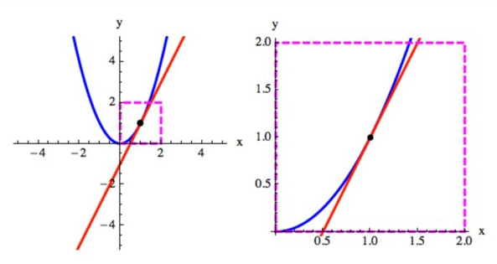
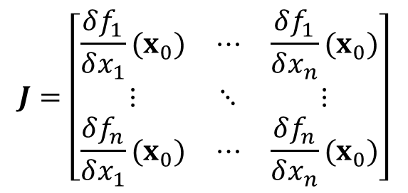
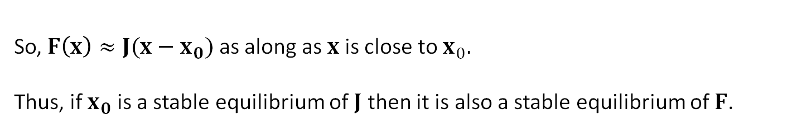
Dynamic Systems: ECT Idea
The equilibrium classification test is based on the idea of local linearity. That is continuous functions look flat when you zoom in.
$$J=\left[\begin{matrix}\frac{δf_{1}}{δx_{1}}(x_{0}) & ⋯ & \frac{δf_{1}}{δx_{n}}(x_{0}) \\ ⋮ & ⋱ & ⋮ \\ \frac{δf_{n}}{δx_{1}}(x_{0}) & ⋯ & \frac{δf_{n}}{δx_{n}}(x_{0})\end{matrix}\right]$$
So, $F\left(x\right)≈J(x−x_{0})$ as along as $x$ is close to $x_{0}.$
Thus, if $x_{0}$ is a stable equilibrium of $J$ then it is also a stable equilibrium of $F$.

Slide 10
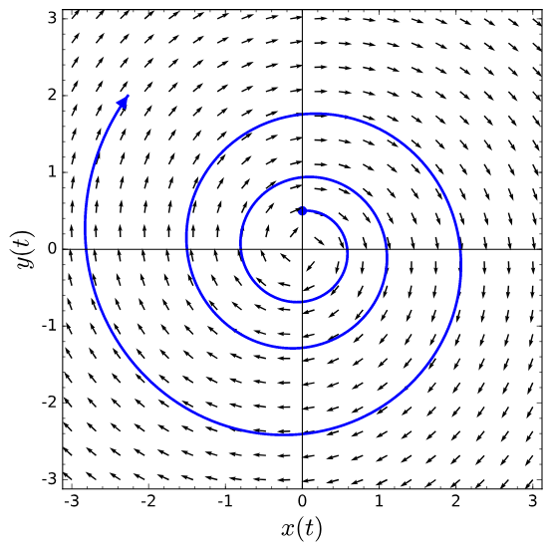
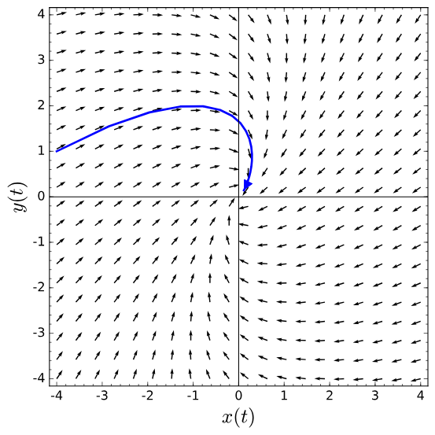
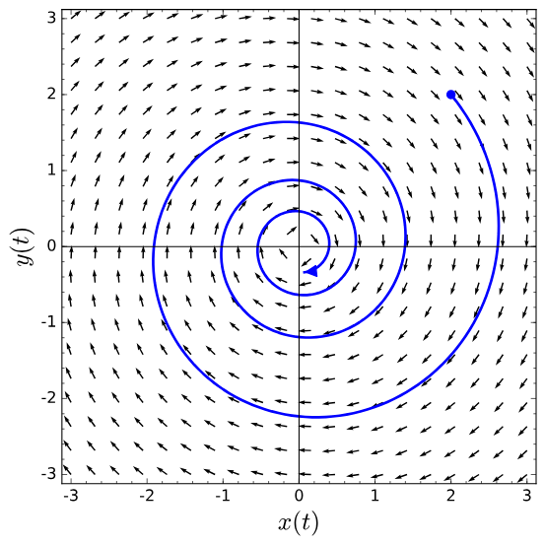
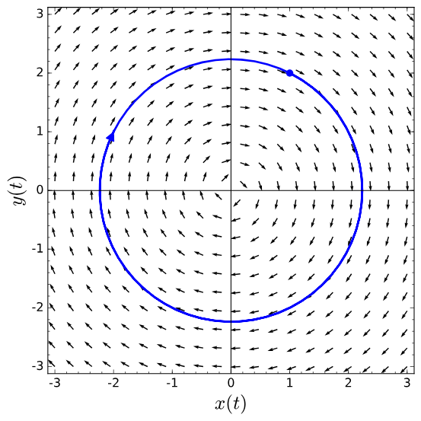
unstable – an eigenvalue has a positive real part
Stable – eigenvalues have negative real parts
All eigenvalues have 0 real part (pure imaginary)

Slide 11
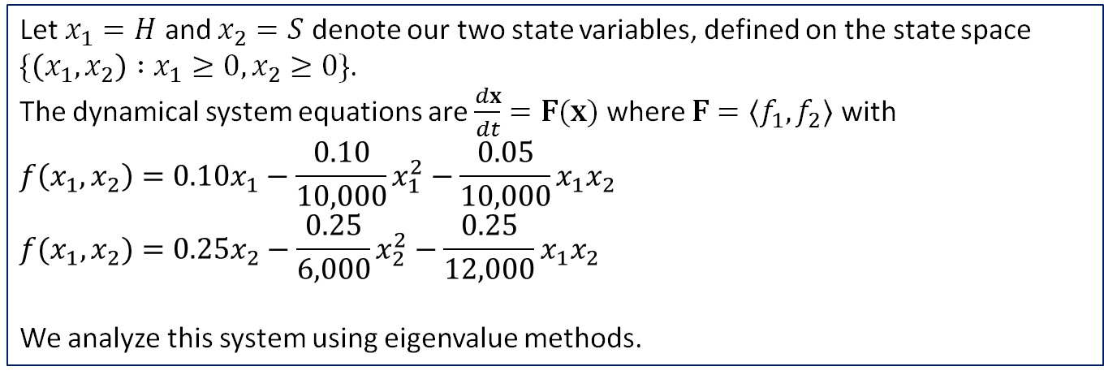
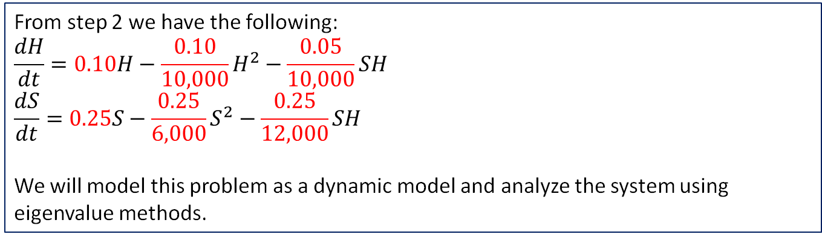
Step 3: Formulate the model
From step 2 we have the following:
$$\frac{dH}{dt}=0.10H−\frac{0.10}{10,000}H^{2}−\frac{0.05}{10,000}SH$$
$$\frac{dS}{dt}=0.25S−\frac{0.25}{6,000}S^{2}−\frac{0.25}{12,000}SH$$
We will model this problem as a dynamic model and analyze the system using eigenvalue methods.
Let $x_{1}=H$ and $x_{2}=S$ denote our two state variables, defined on the state space
$\{\left(x_{1},x_{2}\right) :x_{1}≥0, x_{2}≥0\}$.
The dynamical system equations are $\frac{dx}{dt}=F(x)$ where $F=〈f_{1},f_{2}〉$ with
$$f\left(x_{1},x_{2}\right)=0.10x_{1}−\frac{0.10}{10,000}x_{1}^{2}−\frac{0.05}{10,000}x_{1}x_{2}$$
$$f(x_{1},x_{2})=0.25x_{2}−\frac{0.25}{6,000}x_{2}^{2}−\frac{0.25}{12,000}x_{1}x_{2}$$
We analyze this system using eigenvalue methods.

Slide 12
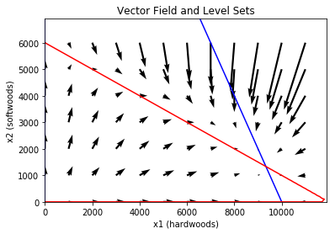
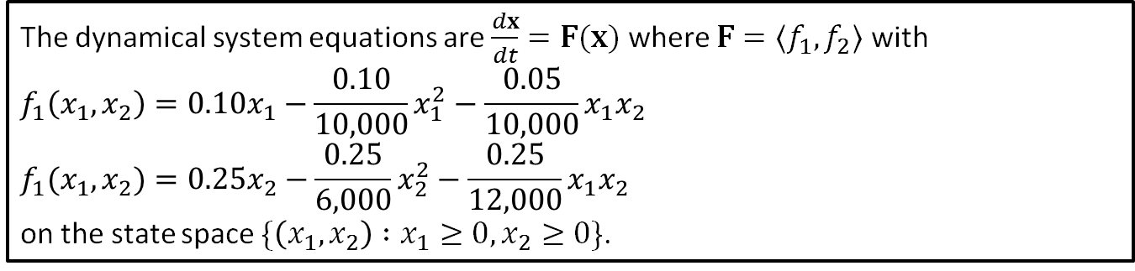
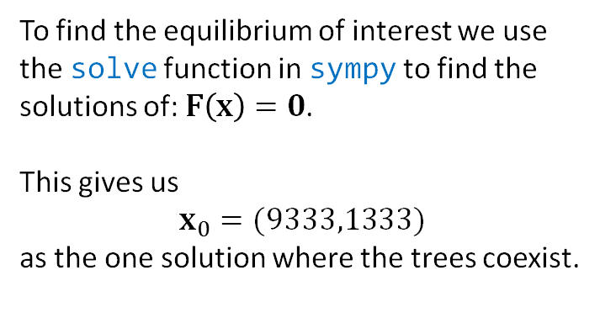
Step 4: Solve the Problem
The dynamical system equations are $\frac{dx}{dt}=F(x)$ where $F=〈f_{1},f_{2}〉$ with
$$f_{1}\left(x_{1},x_{2}\right)=0.10x_{1}−\frac{0.10}{10,000}x_{1}^{2}−\frac{0.05}{10,000}x_{1}x_{2}$$
$$f_{1}(x_{1},x_{2})=0.25x_{2}−\frac{0.25}{6,000}x_{2}^{2}−\frac{0.25}{12,000}x_{1}x_{2}$$
on the state space $\{\left(x_{1},x_{2}\right) :x_{1}≥0, x_{2}≥0\}$.
To find the equilibrium of interest we use the solve function in sympy to find the solutions of: $F\left(x\right)=0$.
This gives us
$$x_{0}=(9333,1333)$$
as the one solution where the trees coexist.
Notes:
See python file section1-1pig.py

Slide 13
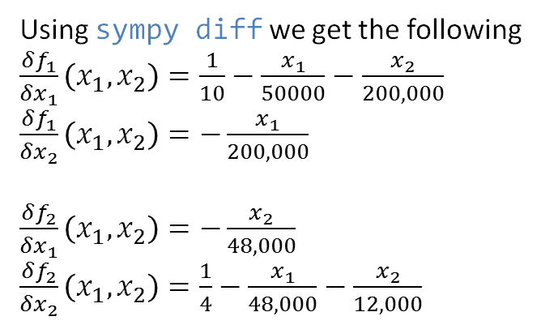
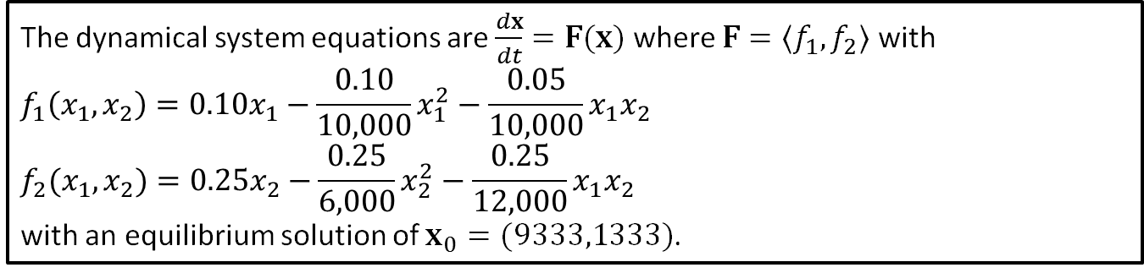
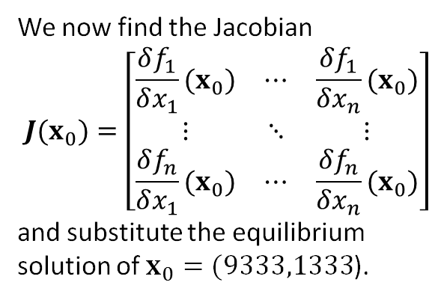
Step 4: Solve the Problem
The dynamical system equations are $\frac{dx}{dt}=F(x)$ where $F=〈f_{1},f_{2}〉$ with
$$f_{1}\left(x_{1},x_{2}\right)=0.10x_{1}−\frac{0.10}{10,000}x_{1}^{2}−\frac{0.05}{10,000}x_{1}x_{2}$$
$$f_{2}(x_{1},x_{2})=0.25x_{2}−\frac{0.25}{6,000}x_{2}^{2}−\frac{0.25}{12,000}x_{1}x_{2}$$
with an equilibrium solution of $x_{0}=(9333,1333)$.
We now find the Jacobian
$$J(x_{0})=\left[\begin{matrix}\frac{δf_{1}}{δx_{1}}(x_{0}) & ⋯ & \frac{δf_{1}}{δx_{n}}(x_{0}) \\ ⋮ & ⋱ & ⋮ \\ \frac{δf_{n}}{δx_{1}}(x_{0}) & ⋯ & \frac{δf_{n}}{δx_{n}}(x_{0})\end{matrix}\right]$$
and substitute the equilibrium solution of $x_{0}=(9333,1333$).
Using sympy diff we get the following
$\frac{δf_{1}}{δx_{1}}\left(x_{1}, x_{2}\right)=\frac{1}{10}−\frac{x_{1}}{50000}−\frac{x_{2}}{200,000}$
$\frac{δf_{1}}{δx_{2}}\left(x_{1}, x_{2}\right)=−\frac{x_{1}}{200,000}$
$\frac{δf_{2}}{δx_{1}}\left(x_{1}, x_{2}\right)=−\frac{x_{2}}{48,000}$
$\frac{δf_{2}}{δx_{2}}\left(x_{1}, x_{2}\right)=\frac{1}{4}−\frac{x_{1}}{48,000}−\frac{x_{2}}{12,000}$
Notes:
See python file section1-1pig.py

Slide 14
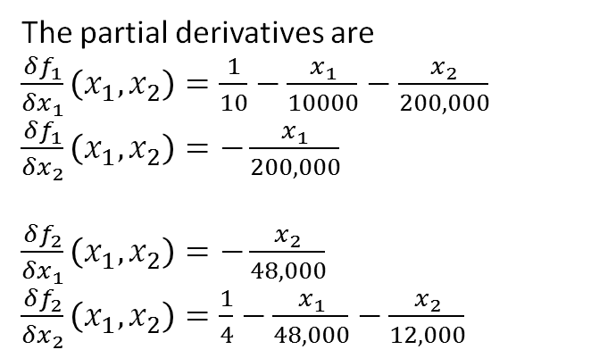
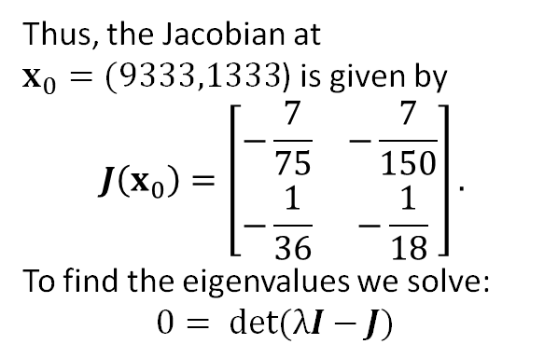
Step 4: Solve the Problem
The dynamical system equations are $\frac{dx}{dt}=F(x)$ where $F=〈f_{1},f_{2}〉$ with
$$f_{1}\left(x_{1},x_{2}\right)=0.10x_{1}−\frac{0.10}{10,000}x_{1}^{2}−\frac{0.05}{10,000}x_{1}x_{2}$$
$$f_{2}(x_{1},x_{2})=0.25x_{2}−\frac{0.25}{6,000}x_{2}^{2}−\frac{0.25}{12,000}x_{1}x_{2}$$
with an equilibrium solution of $x_{0}=(9333,1333)$.
The partial derivatives are
$\frac{δf_{1}}{δx_{1}}\left(x_{1}, x_{2}\right)=\frac{1}{10}−\frac{x_{1}}{10000}−\frac{x_{2}}{200,000}$
$\frac{δf_{1}}{δx_{2}}\left(x_{1}, x_{2}\right)=−\frac{x_{1}}{200,000}$
$\frac{δf_{2}}{δx_{1}}\left(x_{1}, x_{2}\right)=−\frac{x_{2}}{48,000}$
$\frac{δf_{2}}{δx_{2}}\left(x_{1}, x_{2}\right)=\frac{1}{4}−\frac{x_{1}}{48,000}−\frac{x_{2}}{12,000}$
Thus, the Jacobian at $x_{0}=(9333,1333$) is given by
$$J\left(x_{0}\right)=\left[\begin{matrix}−\frac{7}{75} & −\frac{7}{150} \\ −\frac{1}{36} & −\frac{1}{18}\end{matrix}\right].$$
To find the eigenvalues we solve:
$$0= det(λI−J)$$
Notes:
See python file section1-1pig.py

Slide 15
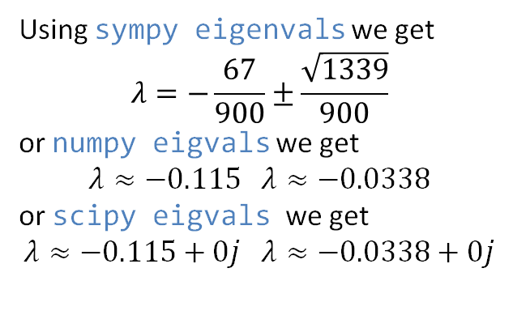
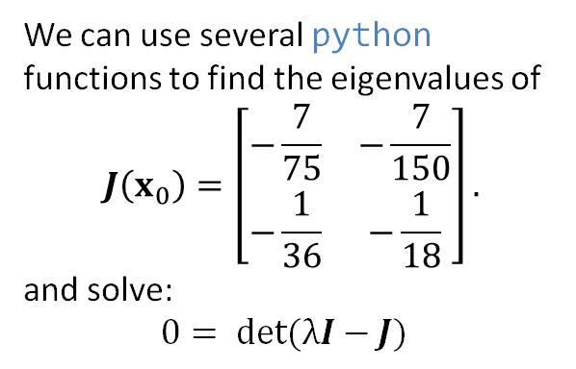
Step 4: Solve the Problem
The dynamical system equations are $\frac{dx}{dt}=F(x)$ where $F=〈f_{1},f_{2}〉$ with
$$f_{1}\left(x_{1},x_{2}\right)=0.10x_{1}−\frac{0.10}{10,000}x_{1}^{2}−\frac{0.05}{10,000}x_{1}x_{2}$$
$$f_{2}(x_{1},x_{2})=0.25x_{2}−\frac{0.25}{6,000}x_{2}^{2}−\frac{0.25}{12,000}x_{1}x_{2}$$
with an equilibrium solution of $x_{0}=(9333,1333)$.
We can use several python functions to find the eigenvalues of
$$J\left(x_{0}\right)=\left[\begin{matrix}−\frac{7}{75} & −\frac{7}{150} \\ −\frac{1}{36} & −\frac{1}{18}\end{matrix}\right].$$
and solve:
$$0= det(λI−J)$$
Using sympy eigenvals we get
$$λ=−\frac{67}{900}±\frac{\sqrt{1339}}{900}$$
or numpy eigvals we get
$$λ≈−0.115 λ≈−0.0338$$
or scipy eigvals we get
$$λ≈−0.115+0j λ≈−0.0338+0j$$
Notes:
See python file section1-1pig.py

Slide 16
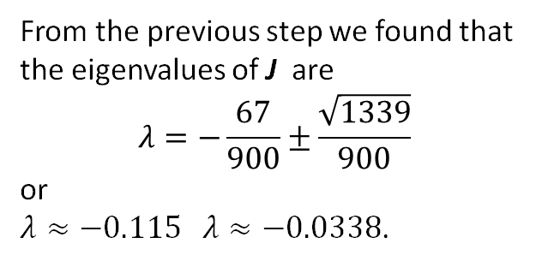
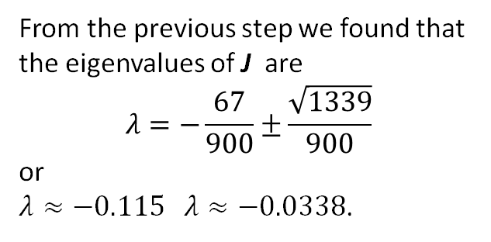
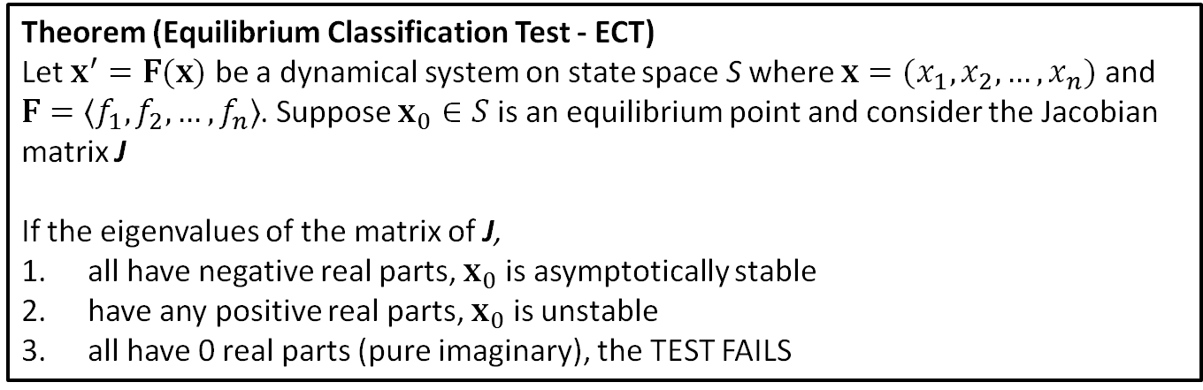
Step 4: Solve the Problem
Theorem (Equilibrium Classification Test - ECT)
Let $x^{′}=F(x)$ be a dynamical system on state space S where $x=(x_{1},x_{2},…,x_{n})$ and $F=〈f_{1},f_{2}, …, f_{n}〉$. Suppose $x_{0}∈S$ is an equilibrium point and consider the Jacobian matrix J
If the eigenvalues of the matrix of J,
all have negative real parts, $x_{0}$ is asymptotically stable
have any positive real parts, $x_{0}$ is unstable
all have 0 real parts (pure imaginary), the TEST FAILS
all have negative real parts, $x_{0}$ is asymptotically stable
From the previous step we found that the eigenvalues of J are
$$λ=−\frac{67}{900}±\frac{\sqrt{1339}}{900}$$
or
$λ≈−0.115 λ≈−0.0338$.
From the previous step we found that the eigenvalues of J are
$$λ=−\frac{67}{900}±\frac{\sqrt{1339}}{900}$$
or
$λ≈−0.115 λ≈−0.0338$.
Notes:
See python file section1-1pig.py

Slide 17
Step 5: Answer the question
We have found that there is a stable equilibrium for our dynamical system at
(9333,1333).
Therefore, we have found that hardwoods and softwoods can coexist in stable equilibrium. At equilibrium there will approximately 9333 tons per acre of hardwood and 1333 tons per acre of softwoods in the stable forest.
We made an assumption about the degree of competition between the two types of trees. In particular we assumed the competition rate between the two different times was half of competition rate among the same species.
A sensitivity analysis needs to be conducted on this assumption.

Slide 18
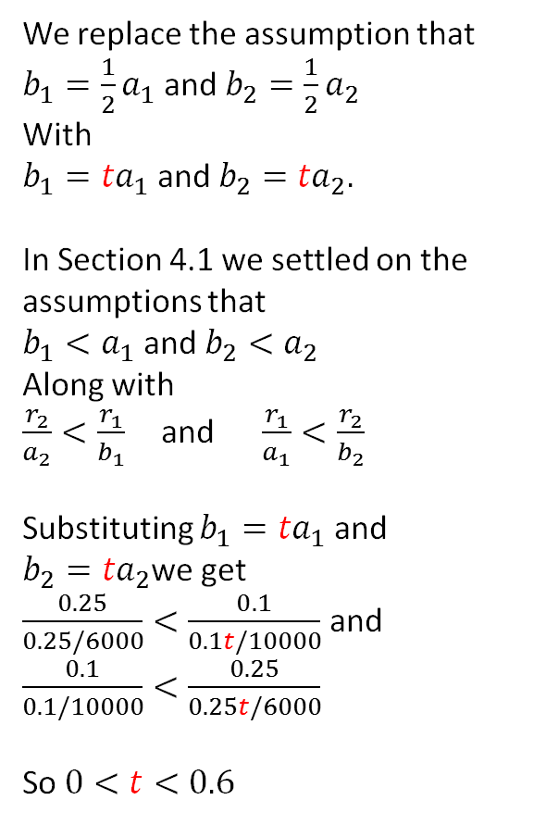
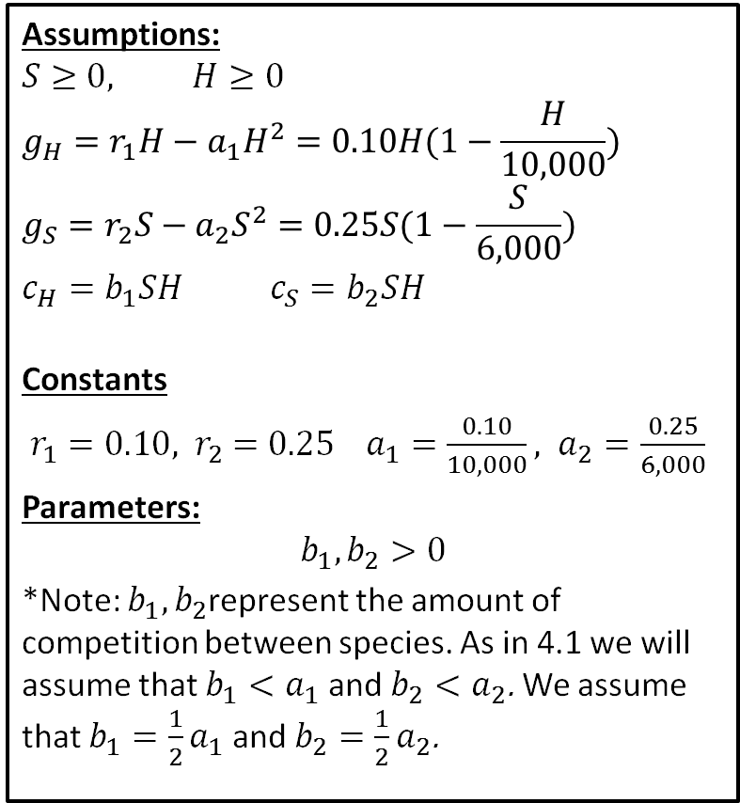
Sensitivity Analysis
Assumptions:
$$S≥0, H≥0$$
$$g_{H}=r_{1}H−a_{1}H^{2}=0.10H(1−\frac{H}{10,000})$$
$$g_{S}=r_{2}S−a_{2}S^{2}=0.25S(1−\frac{S}{6,000})$$
$$c_{H}=b_{1}SH{ c}_{S}=b_{2}SH$$
Constants
$r_{1}=0.10, { r}_{2}=0.25 a_{1}=\frac{0.10}{10,000}, a_{2}=\frac{0.25}{6,000}$
Parameters:
$$b_{1},b_{2}>0$$
*Note: $b_{1},b_{2}$represent the amount of competition between species. As in 4.1 we will assume that ${b_{1}<a}_{1}$ and ${b_{2}<a}_{2}$. We assume that ${b_{1}=\frac{1}{2}a}_{1}$ and ${b_{2}=\frac{1}{2}a}_{2}$.
We replace the assumption that
${b_{1}=\frac{1}{2}a}_{1}$ and ${b_{2}=\frac{1}{2}a}_{2}$
With
${b_{1}=ta}_{1}$ and ${b_{2}=ta}_{2}.$
In Section 4.1 we settled on the assumptions that
${b_{1}<a}_{1}$ and ${b_{2}<a}_{2}$
Along with
$\frac{r_{2}}{a_{2}}<\frac{r_{1}}{b_{1}}$ and $\frac{r_{1}}{a_{1}}<\frac{r_{2}}{b_{2}}$
Substituting ${b_{1}=ta}_{1}$ and ${b_{2}=ta}_{2}$we get
$\frac{0.25}{0.25/6000}<\frac{0.1}{0.1t/10000}$ and $\frac{0.1}{0.1/10000}<\frac{0.25}{0.25t/6000}$
So $0<t<0.6$

Slide 19
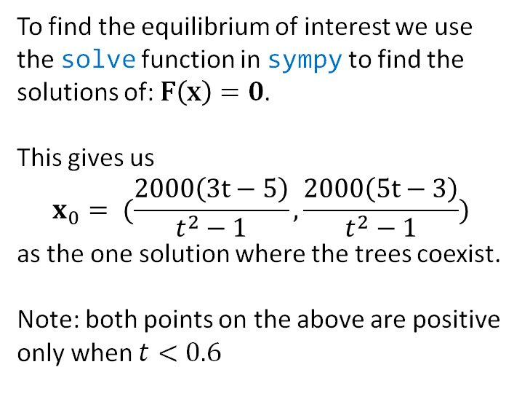
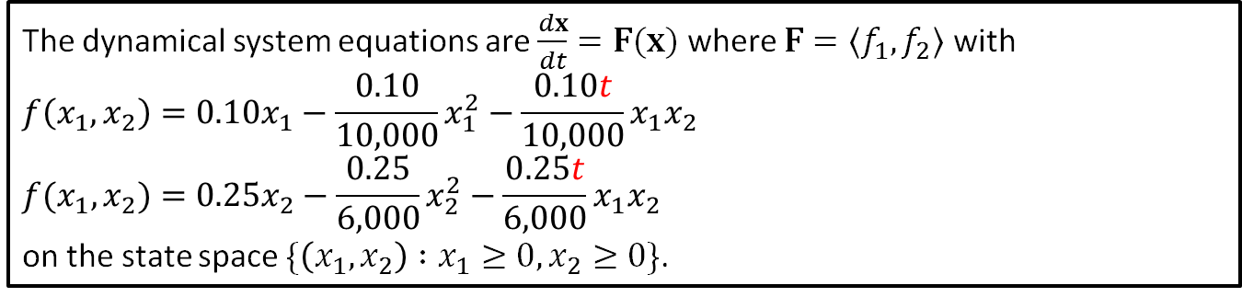
Equilibrium
The dynamical system equations are $\frac{dx}{dt}=F(x)$ where $F=〈f_{1},f_{2}〉$ with
$$f\left(x_{1},x_{2}\right)=0.10x_{1}−\frac{0.10}{10,000}x_{1}^{2}−\frac{0.10t}{10,000}x_{1}x_{2}$$
$$f(x_{1},x_{2})=0.25x_{2}−\frac{0.25}{6,000}x_{2}^{2}−\frac{0.25t}{6,000}x_{1}x_{2}$$
on the state space $\{\left(x_{1},x_{2}\right) :x_{1}≥0, x_{2}≥0\}$.
To find the equilibrium of interest we use the solve function in sympy to find the solutions of: $F\left(x\right)=0$.
This gives us
$$x_{0}= (\frac{2000\left(3t−5\right)}{t^{2}−1},\frac{2000\left(5t−3\right)}{t^{2}−1})$$
as the one solution where the trees coexist.
Note: both points on the above are positive only when $t<0.6$
Notes:
See python file section1-1pig.py

Slide 20
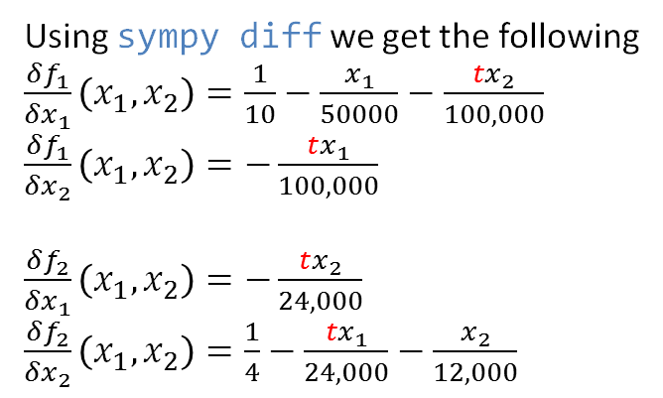
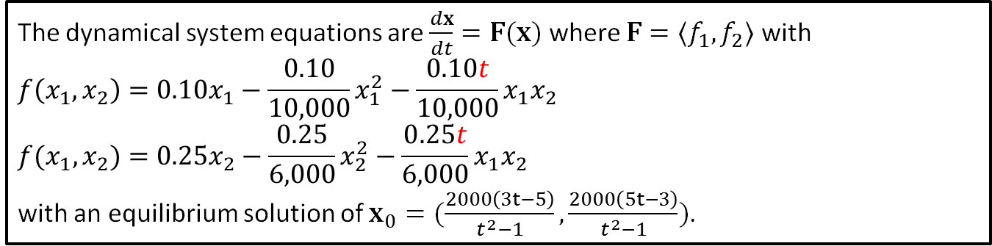
Jacobian
The dynamical system equations are $\frac{dx}{dt}=F(x)$ where $F=〈f_{1},f_{2}〉$ with
$$f\left(x_{1},x_{2}\right)=0.10x_{1}−\frac{0.10}{10,000}x_{1}^{2}−\frac{0.10t}{10,000}x_{1}x_{2}$$
$$f(x_{1},x_{2})=0.25x_{2}−\frac{0.25}{6,000}x_{2}^{2}−\frac{0.25t}{6,000}x_{1}x_{2}$$
with an equilibrium solution of $x_{0}=(\frac{2000\left(3t−5\right)}{t^{2}−1},\frac{2000\left(5t−3\right)}{t^{2}−1})$.
We now find the Jacobian
$$J(x_{0})=\left[\begin{matrix}\frac{δf_{1}}{δx_{1}}(x_{0}) & ⋯ & \frac{δf_{1}}{δx_{n}}(x_{0}) \\ ⋮ & ⋱ & ⋮ \\ \frac{δf_{n}}{δx_{1}}(x_{0}) & ⋯ & \frac{δf_{n}}{δx_{n}}(x_{0})\end{matrix}\right]$$
and substitute the equilibrium solution of $x_{0}=(9333,1333$).
Using sympy diff we get the following
$\frac{δf_{1}}{δx_{1}}\left(x_{1}, x_{2}\right)=\frac{1}{10}−\frac{x_{1}}{50000}−\frac{{tx}_{2}}{100,000}$
$\frac{δf_{1}}{δx_{2}}\left(x_{1}, x_{2}\right)=−\frac{tx_{1}}{100,000}$
$\frac{δf_{2}}{δx_{1}}\left(x_{1}, x_{2}\right)=−\frac{tx_{2}}{24,000}$
$\frac{δf_{2}}{δx_{2}}\left(x_{1}, x_{2}\right)=\frac{1}{4}−\frac{{tx}_{1}}{24,000}−\frac{x_{2}}{12,000}$
Notes:
See python file section1-1pig.py

Slide 21
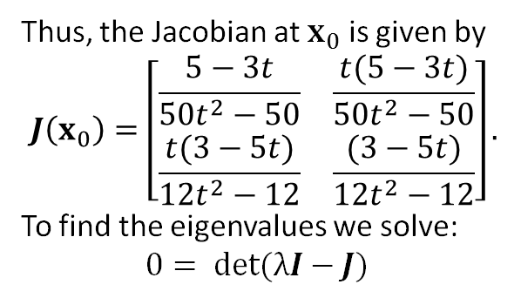
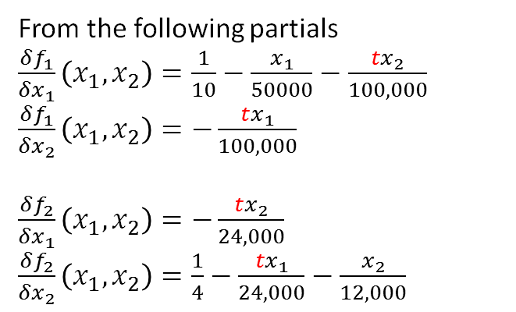
Eigenvalues
The dynamical system equations are $\frac{dx}{dt}=F(x)$ where $F=〈f_{1},f_{2}〉$ with
$$f\left(x_{1},x_{2}\right)=0.10x_{1}−\frac{0.10}{10,000}x_{1}^{2}−\frac{0.10t}{10,000}x_{1}x_{2}$$
$$f(x_{1},x_{2})=0.25x_{2}−\frac{0.25}{6,000}x_{2}^{2}−\frac{0.25t}{6,000}x_{1}x_{2}$$
with an equilibrium solution of $x_{0}=(\frac{2000\left(3t−5\right)}{t^{2}−1},\frac{2000\left(5t−3\right)}{t^{2}−1})$.
From the following partials
$\frac{δf_{1}}{δx_{1}}\left(x_{1}, x_{2}\right)=\frac{1}{10}−\frac{x_{1}}{50000}−\frac{{tx}_{2}}{100,000}$
$\frac{δf_{1}}{δx_{2}}\left(x_{1}, x_{2}\right)=−\frac{tx_{1}}{100,000}$
$\frac{δf_{2}}{δx_{1}}\left(x_{1}, x_{2}\right)=−\frac{tx_{2}}{24,000}$
$\frac{δf_{2}}{δx_{2}}\left(x_{1}, x_{2}\right)=\frac{1}{4}−\frac{{tx}_{1}}{24,000}−\frac{x_{2}}{12,000}$
Thus, the Jacobian at $x_{0}$ is given by
$$J\left(x_{0}\right)=\left[\begin{matrix}\frac{5−3t}{50t^{2}−50} & \frac{t(5−3t)}{50t^{2}−50} \\ \frac{t(3−5t)}{12t^{2}−12} & \frac{(3−5t)}{12t^{2}−12}\end{matrix}\right].$$
To find the eigenvalues we solve:
$$0= det(λI−J)$$
Notes:
See python file section1-1pig.py

Slide 22
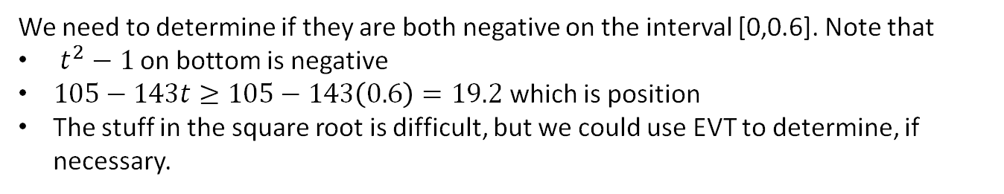
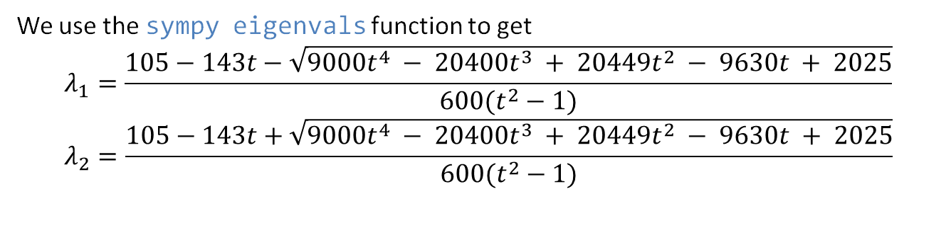
Eigenvalues
The dynamical system equations are $\frac{dx}{dt}=F(x)$ where $F=〈f_{1},f_{2}〉$ with
$$f\left(x_{1},x_{2}\right)=0.10x_{1}−\frac{0.10}{10,000}x_{1}^{2}−\frac{0.10t}{10,000}x_{1}x_{2}$$
$$f(x_{1},x_{2})=0.25x_{2}−\frac{0.25}{6,000}x_{2}^{2}−\frac{0.25t}{6,000}x_{1}x_{2}$$
with an equilibrium solution of $x_{0}=(\frac{2000\left(3t−5\right)}{t^{2}−1},\frac{2000\left(5t−3\right)}{t^{2}−1})$.
We use the sympy eigenvals function to get
$$λ_{1}=\frac{105−143t−\sqrt{9000t^{4} − 20400t^{3} + 20449t^{2} − 9630t + 2025}}{600(t^{2}−1)}$$
$$λ_{2}=\frac{105−143t+\sqrt{9000t^{4} − 20400t^{3} + 20449t^{2} − 9630t + 2025}}{600(t^{2}−1)}$$
We need to determine if they are both negative on the interval [0,0.6]. Note that
$t^{2}−1$ on bottom is negative
$105−143t≥105−143\left(0.6\right)=19.2$ which is position
The stuff in the square root is difficult, but we could use EVT to determine, if necessary.
Notes:
Note sign is opposite of that in the book because the 1-t^2 in the denominator is t^2-1

Slide 23
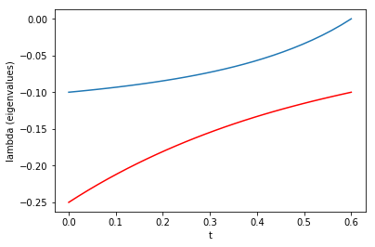
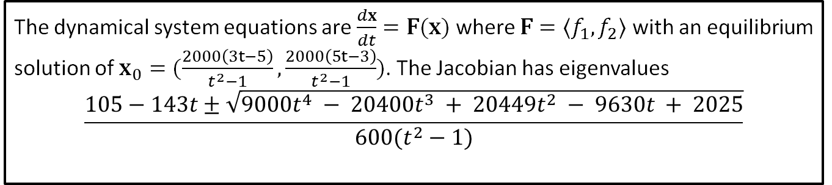
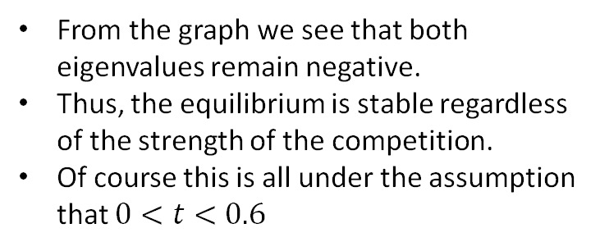
Conclusion
The dynamical system equations are $\frac{dx}{dt}=F(x)$ where $F=〈f_{1},f_{2}〉$ with an equilibrium solution of $x_{0}=(\frac{2000\left(3t−5\right)}{t^{2}−1},\frac{2000\left(5t−3\right)}{t^{2}−1})$. The Jacobian has eigenvalues
$$\frac{105−143t±\sqrt{9000t^{4} − 20400t^{3} + 20449t^{2} − 9630t + 2025}}{600(t^{2}−1)}$$
We plot the eigenvalues over the interval [0, 0.6] to determine if they remain negative.
From the graph we see that both eigenvalues remain negative.
Thus, the equilibrium is stable regardless of the strength of the competition.
Of course this is all under the assumption that $0<t<0.6$

